Slide 1
Topic and English Home Learning Kindertransport Please email willow@shawwood.doncaster.sch.uk
Week beginning Monday 15th November

Slide 2
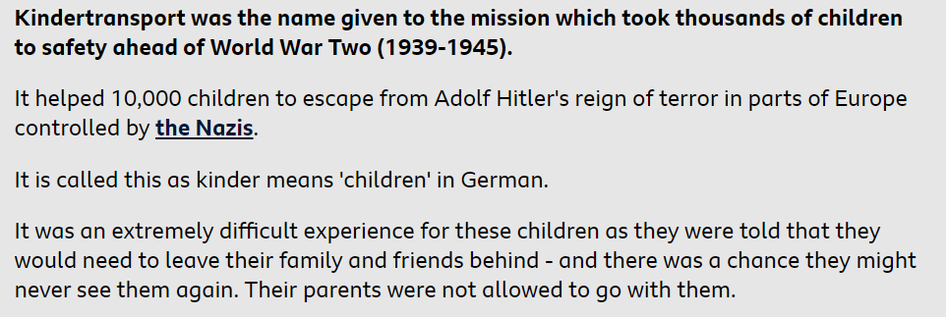
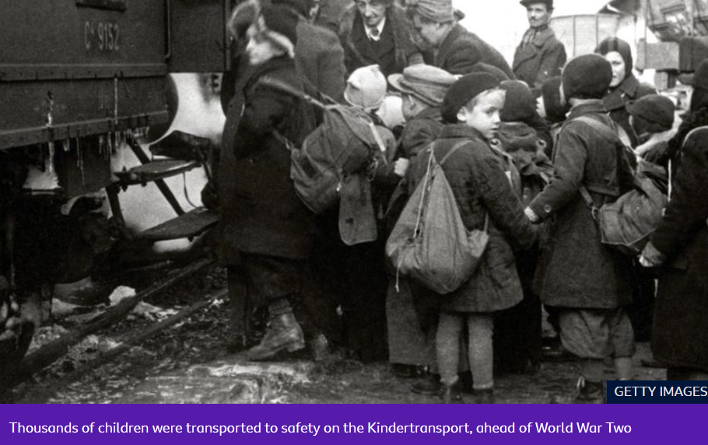
Slide 1
What was Kindertransport?
Read the information from pages 1- 4 and complete the task. You can find additional information on the following websites:
https://www.bbc.co.uk/newsround/46877532
https://www.nationalarchives.gov.uk/education/resources/kindertransport/
https://www.youtube.com/watch?v=Era_O5PS0bA
https://www.youtube.com/watch?v=GFQSPl545EA

Slide 3
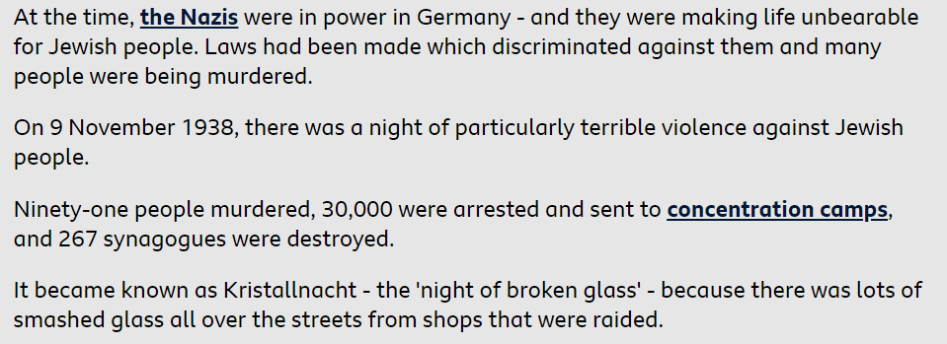
Slide 2

Slide 4
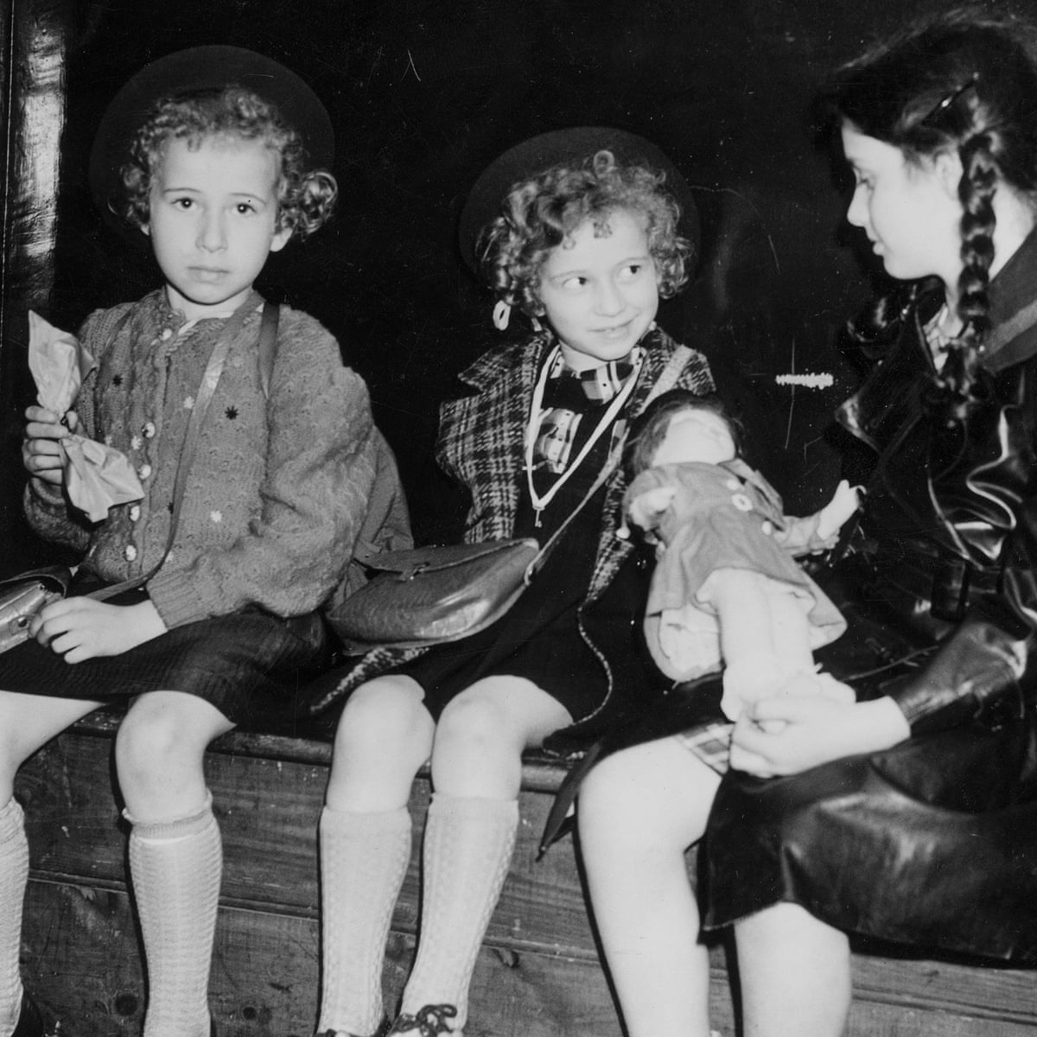
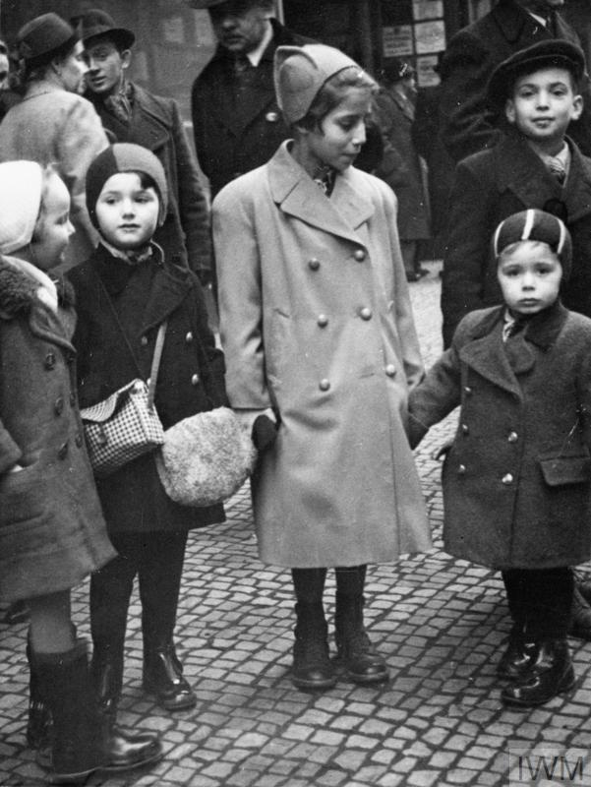
Slide 3

Slide 5
Slide 4
Monday 15th November Task
After reading the information on Kindertransport (slides 1-4) create a timeline of events.
Be creative as you can, you can include pictures and evidence.
If you have access to the internet, it may be useful for you to research and add any additional information you find to you timeline.
Please send your work into willow@shawwood.doncaster.sch.uk

Slide 6
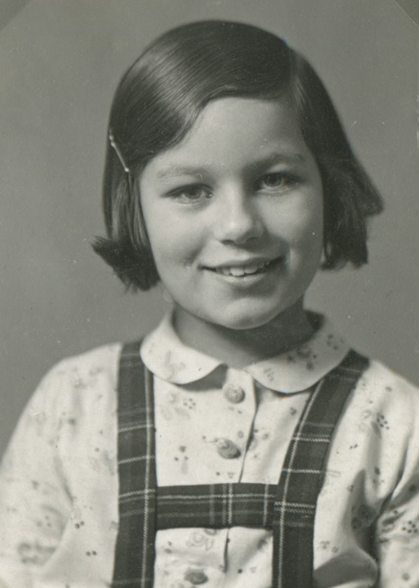
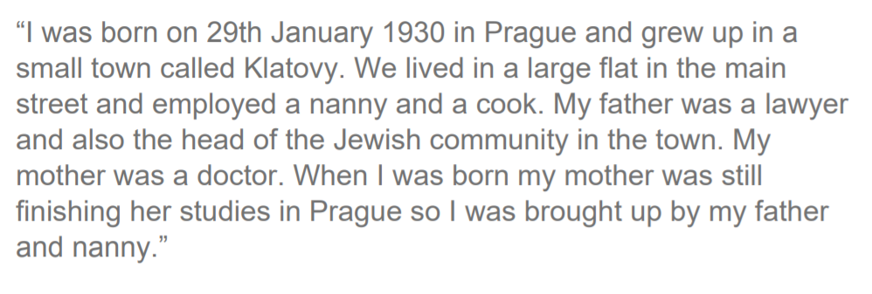
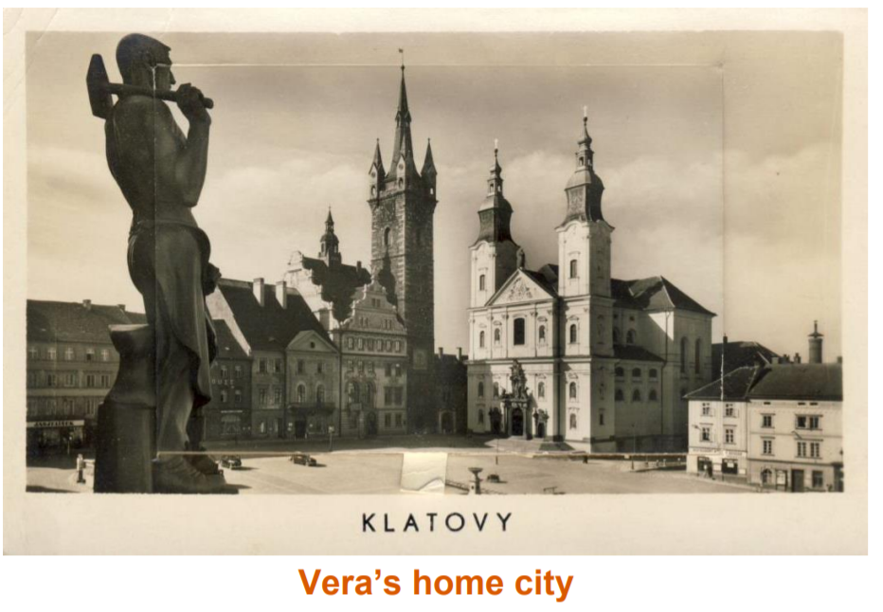
Tuesday 16th November
Vera’s story
Complete a mind map on the worksheet (on slide 10) or on paper, using the images and text on the next 5 slides to record as many facts as you can find on Vera’s early childhood.
Slide 5

Slide 7
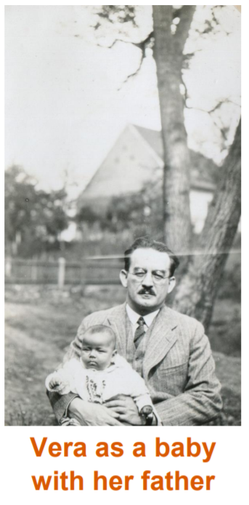
Slide 6

Slide 8
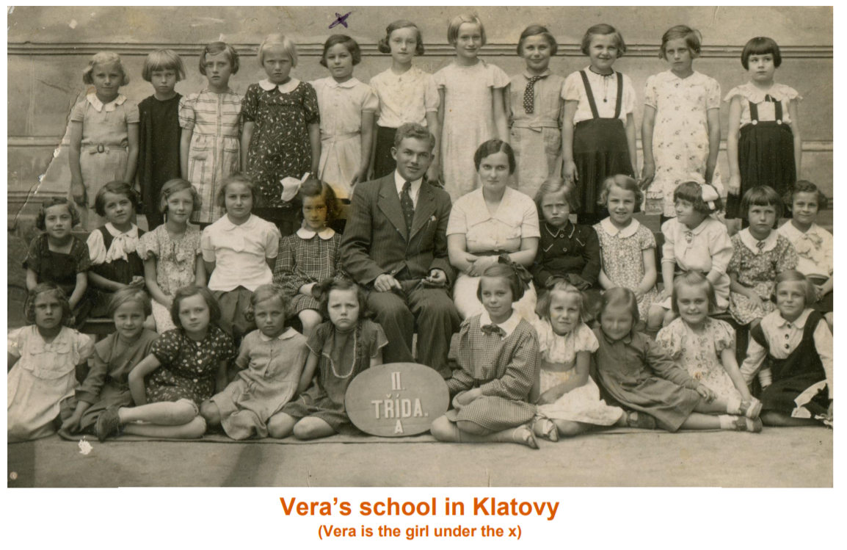
Slide 7

Slide 9
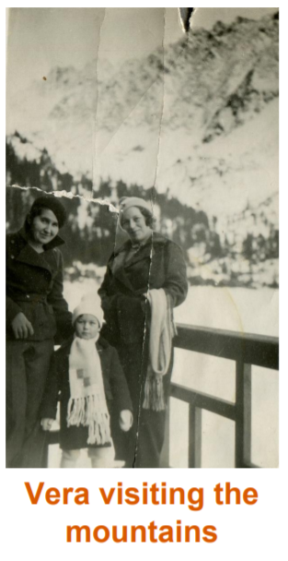
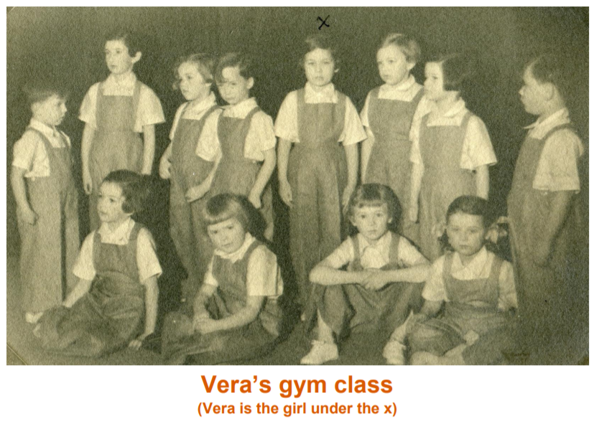
Slide 8

Slide 10
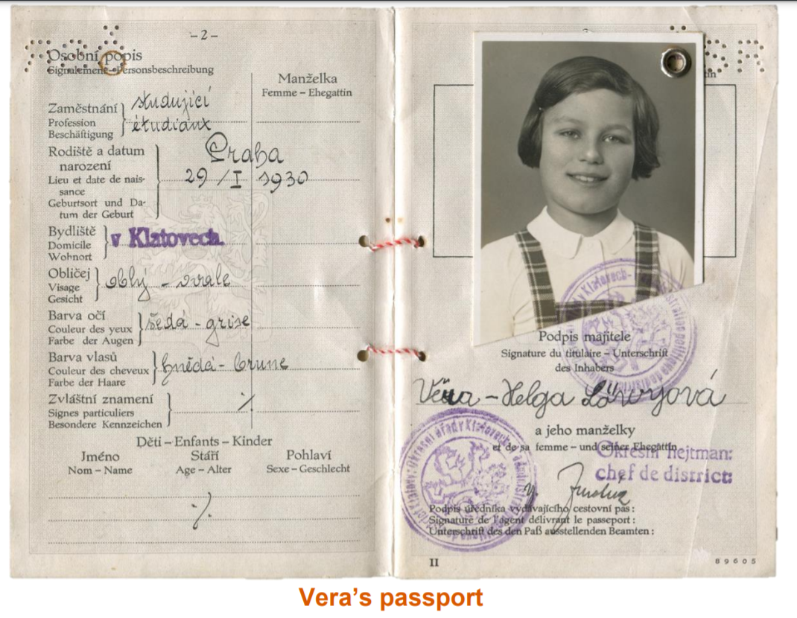
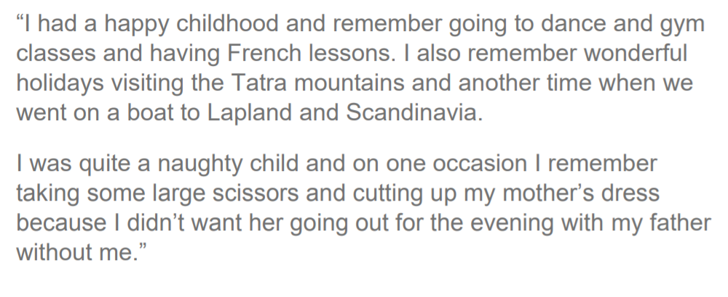
Slide 9

Slide 11
Slide 10
Create your mind map on here!

