Slide 1
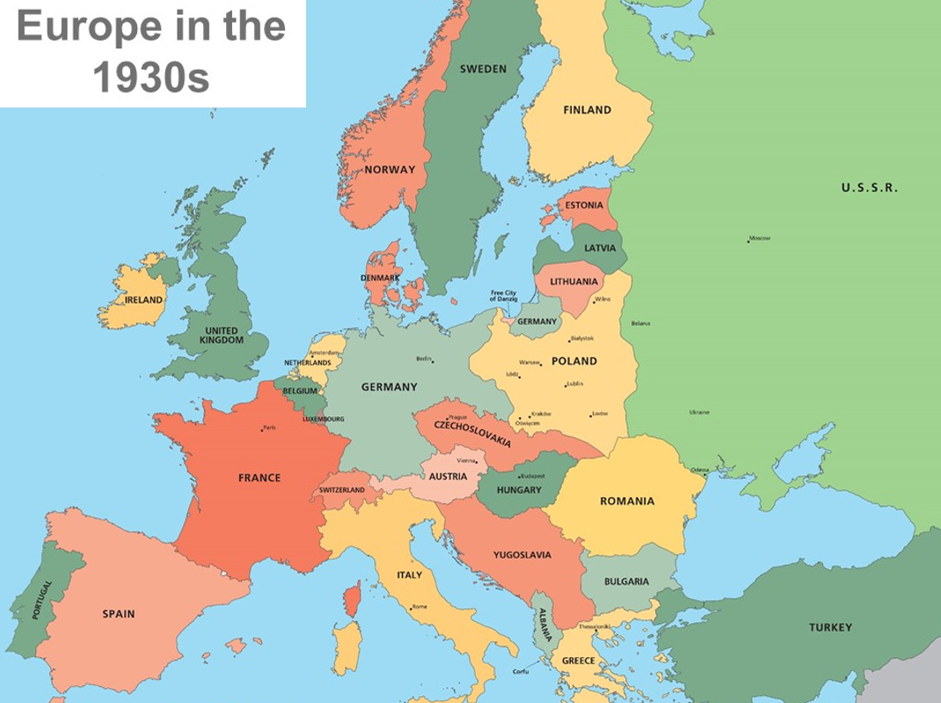
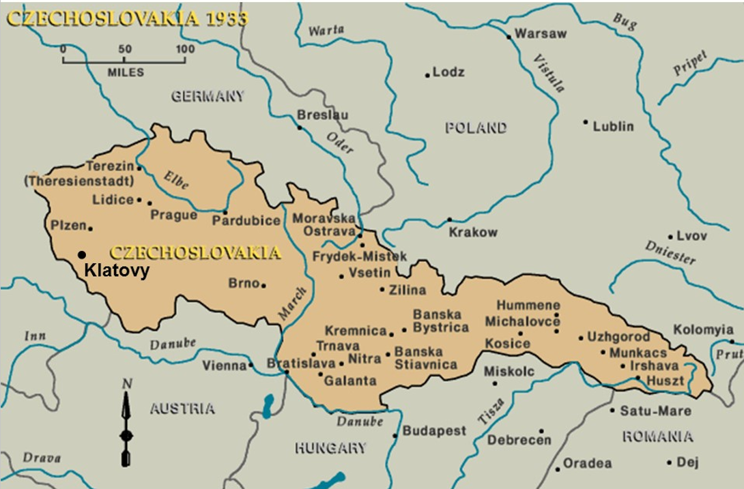
Slide 11
Wednesday 17th November 2021
Look at the map of Europe- locate Czechoslovakia. What do you notice about it’s location?

Slide 2
Slide 12
Wednesday 17th November-Task
Read carefully through Vera’s journey up to slide 20. For each slide, make notes in the blue thought bubbles on how you think Vera may have felt and why.

Slide 3
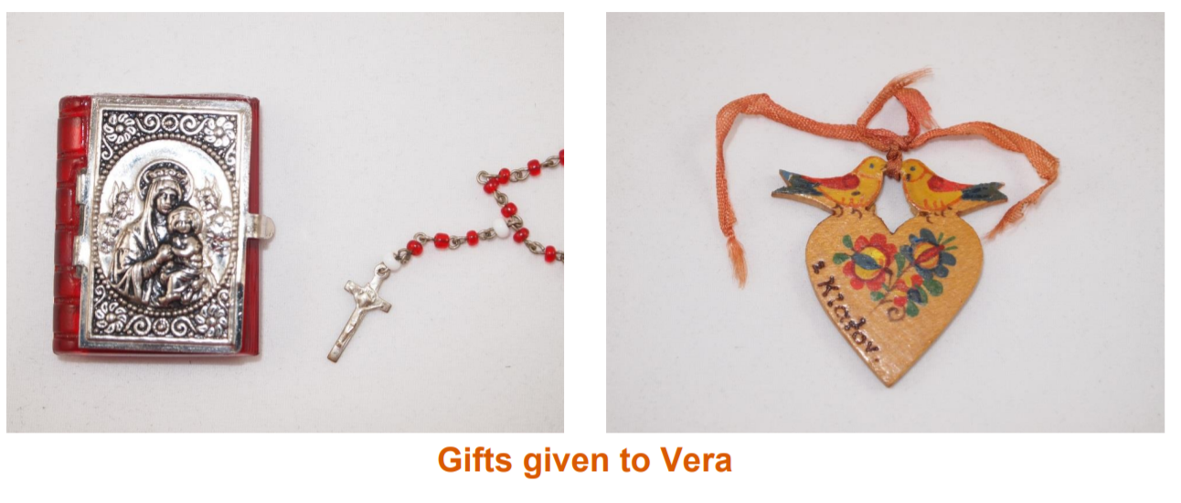
Slide 13

Slide 4
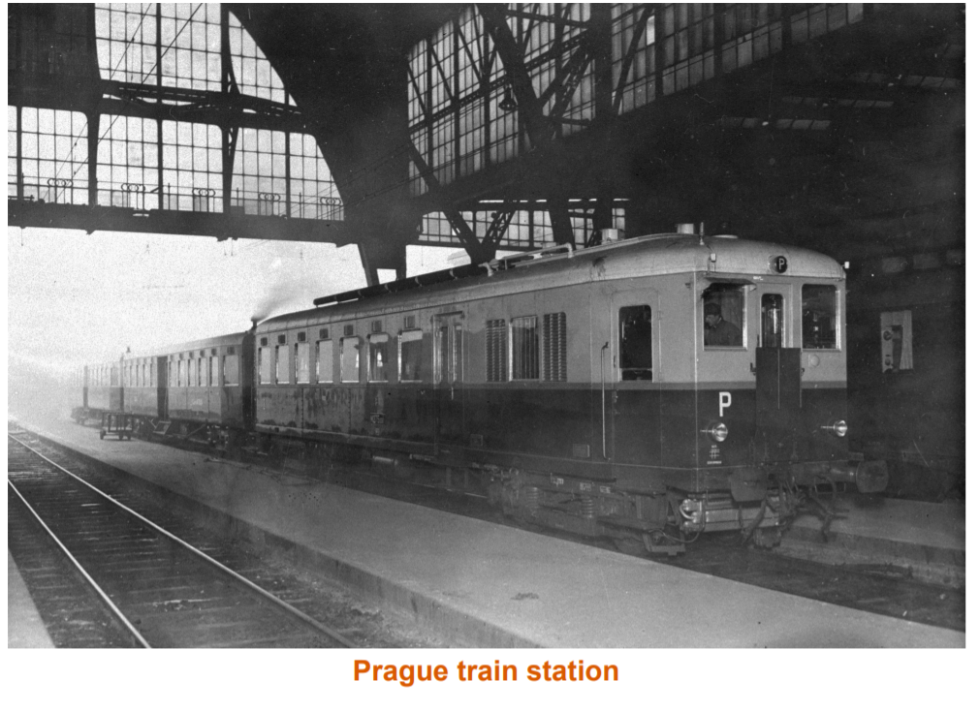
Slide 14

Slide 5
Slide 15

Slide 6
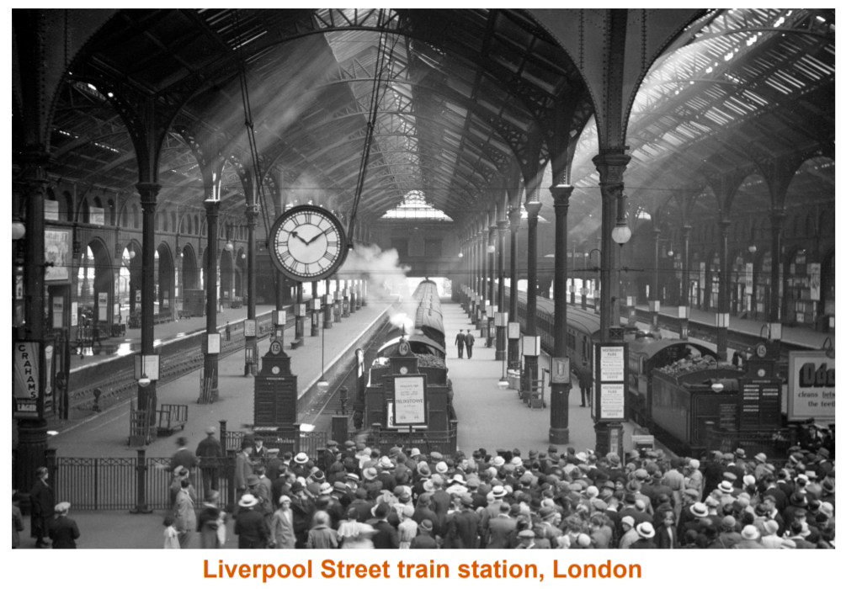
Slide 16

Slide 7
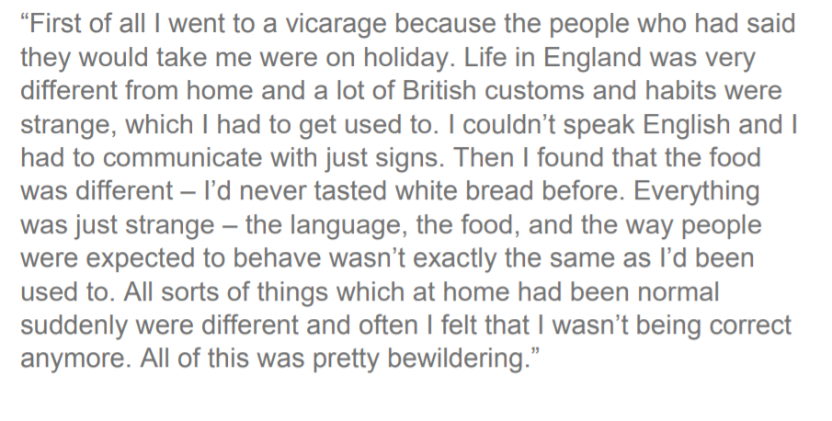
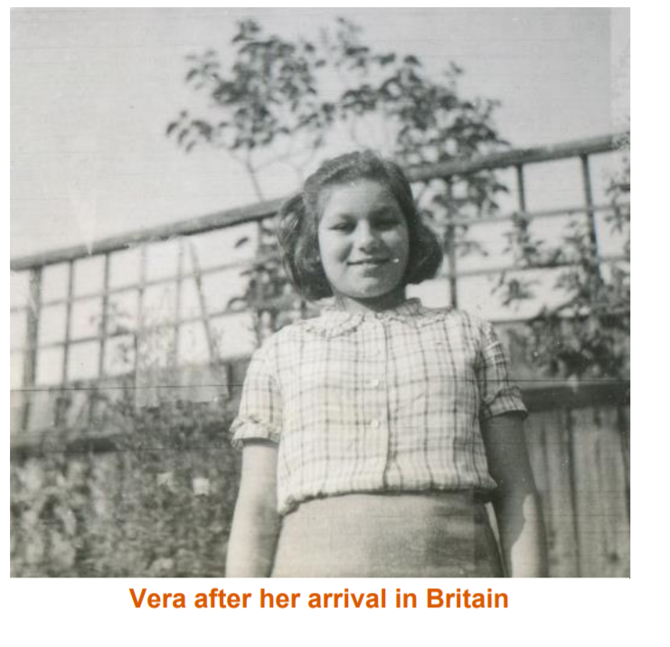
Slide 17

Slide 8
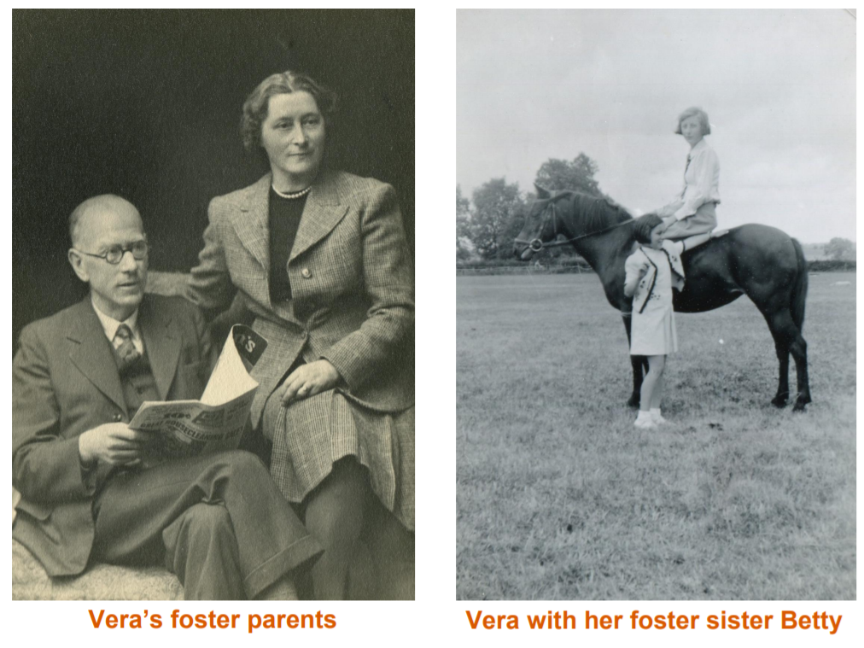
Slide 18

Slide 9
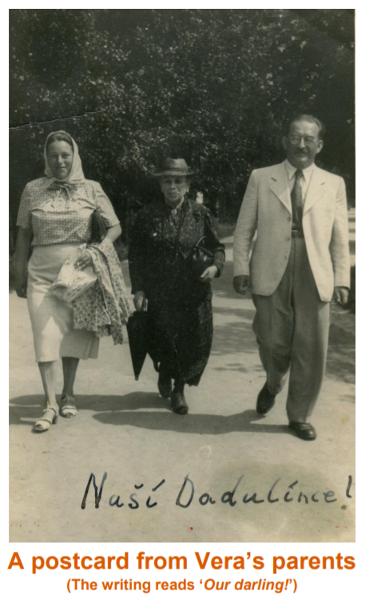
Slide 19

Slide 10
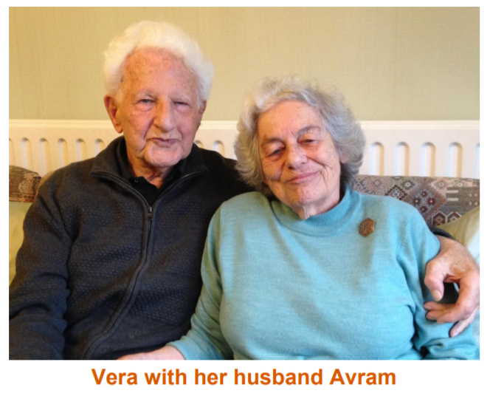
Slide 20

Slide 11
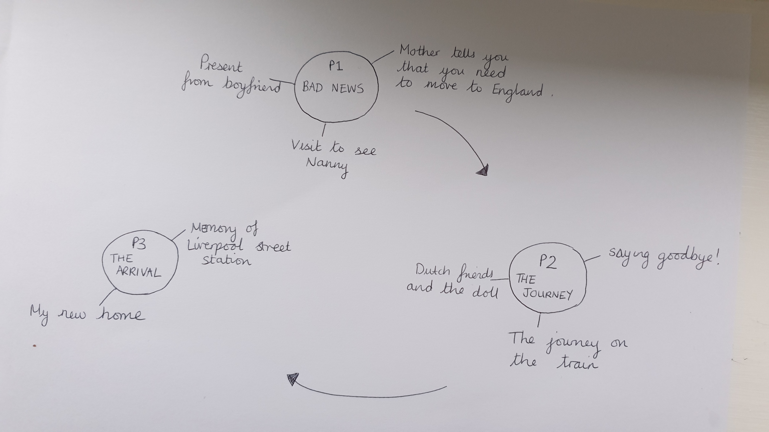
Thursday 18th and Friday 19th November 2021
We would like you to plan and write the diary of Vera’s journey. Please spilt this into 3 paragraphs, use the plan below to help you. Use your knowledge and learning from the evacuation diary you wrote in school. Look at the next page for the features of a diary. There is an example of a diary extract on slide 23.
Slide 21

Slide 12
Slide 22

Slide 13
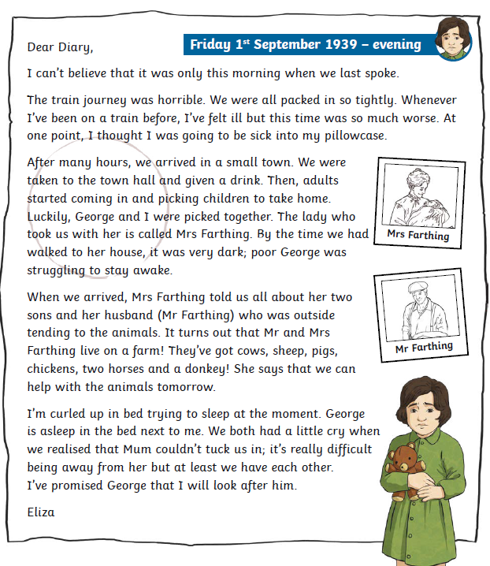
Slide 23

